Slide 1
Household Water Treatment
Step 1 – Make Water Clear
Straining
Pour through fine cloth
Sedimentation
Leave water to settle

Slide 2
Household Water Treatment
Step 2 – Disinfection
Boiling
Must be bubbling for at least 1 minute
Solar Disinfection
In clear bottle in the sun for at least 5 hours

Slide 3
Safe Storage and Handling
Container Types
Use sealed or thin opening
Wash Hands Before Use
Keep Clean

Slide 4
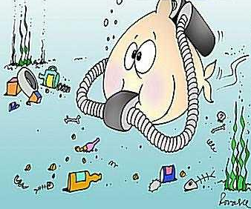
Wise Water Use
Turn Off Taps After Use
Report Problems to Water Committee
Do not pollute your water

Slide 5
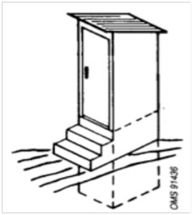
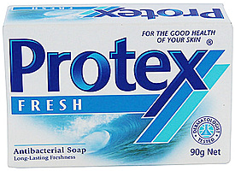
BEFORE EMERGENCY – PREPARATION
A Water Committee has 3 main responsibilities in a disaster:
WATER – Provide enough safe water
SANITATION – Ensure excreta is disposed of safely
HYGIENE – Good hygiene is maintained
WHEN YOU FIRST HEAR THAT A NATURAL DISASTER IS GOING TO HAPPEN – PREPARE
WATER
SANITATION
HYGIENE
1. Store enough water in house (approx. 100l/p)
Aim to use <15l/p/d in short term
1. Designate community sanitation areas (should be on high ground above flood water)
1. Reinforce hygiene messages to community
2. Ensure the ability to boil water
2. Ensure hygiene materials are available
3. Secure your water system:
Close valves
Secure covers
Turn off taps
Tie down/ remove gutters
2. Seal septic tanks and clean (remove waste) from toilet pits where possible
PREVENT POLLUTING FLOOD WATER

Slide 6
AFTER EMERGENCY – RECOVER
ONCE THE DISASTER HAS PASSED AND IT IS SAFE TO DO SO – RESPOND AND RECOVER
WATER
SANITATION
HYGIENE
1. Restore water flow / quantity from system
See instructions in “Piped Distribution”
Re-Connect gutters
ENSURE PEOPLE BOIL WATER UNTIL SYSTEM HAS BEEN CHECKED AND REPAIRED IN 2.
1. Community ONLY TO USE toilets that are not flooded or are in safe designated area
PRIORITY IS THAT EXCRETA IS DISPOSED OF SAFELY
1. Continue to reinforce hygiene messages to community
2. Perform Sanitary Survey of Toilets – Establish which are safe to use and which need repair
2. Perform Sanitary Survey of System – Clean and Repair Source
3. Keep CLEANING working toilets
3. Repair other parts of the system
4. Repair Toilets and Sanitation
IF YOU HAVE NO WATER OR YOU THINK YOUR WATER IS VERY UNSAFE CONTACT THE GOVERNMENT IMMEDIATELY

