Slide 1
Drinking Water Safety & Security Planning
Part 2 Implementing DWSSP
Assembling the Water Safety Planning Team
DWSSP Programme

Slide 2
Assembling a DWSSP Team/Water Committee
Why do we need a team/committee?
Need a group of people to continually manage the water and sanitation system
Ensure water and sanitation needs are balanced against other priorities
Provide a focal point for communication with external stakeholders e.g. government, NGO’s etc.
Raise awareness within the community on water and sanitation issues

Slide 3
Assembling the DWSSP Team - Exercise
Establishing Roles
Each group to look at the visuals laid out and provide answers for the different activities being undertaken
List the types of roles e.g. chairman / treasurer that you think need to be in the water committee

Slide 4
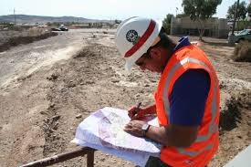
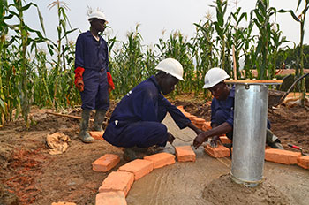
DWSSP Team Roles
Assessment
Inspection
Building

Slide 5
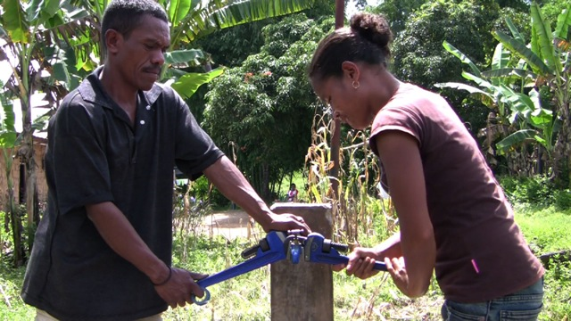
DWSSP Team Roles
Maintenance
Money

Slide 6
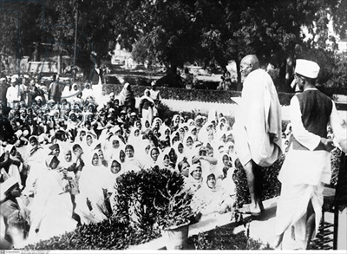
DWSSP Team Roles
Plan & Manage
Raise Awareness

Slide 7
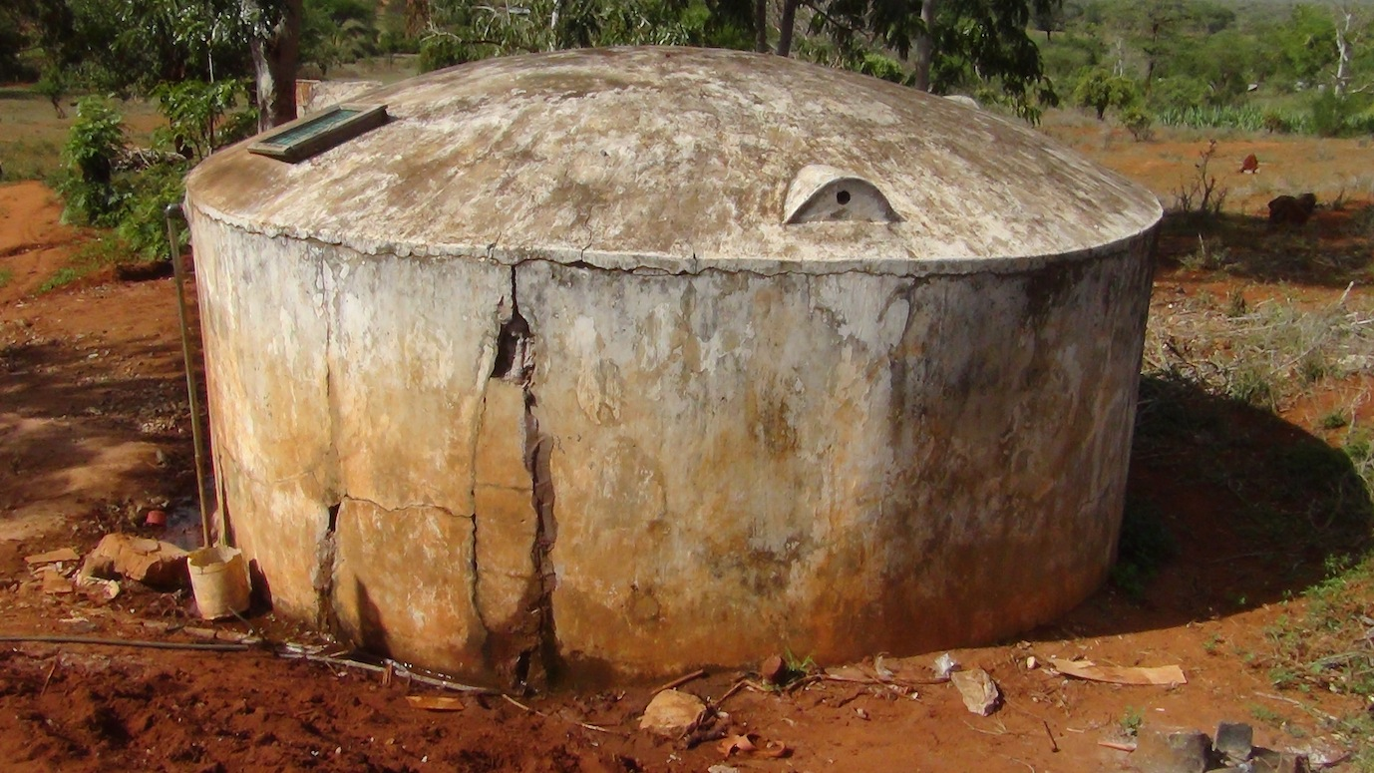
DWSSP Team Roles
Is this in good condition?
A water committee should be able to evaluate when action is needed

Slide 8
Assembling the DWSSP Team - Exercise
Documenting the Team
Each group to discuss within the group what roles they need on their water committee
Once decided then write these in section 1 of their Drinking Water Safety and Security Plan
When finished, present back to group on the roles selected and why you have included them

Slide 9
End of Session

