Slide 1

Drinking Water Safety & Security Planning
Part 2 Implementing DWSSP
Describing the System – Community Mapping
DWSSP Programme

Slide 2
Describing the system
Why do we need to describe the system?
Useful source of information for identifying problems
Provides information for planning
Baseline description of the supply allows the community to monitor changes and improvements

Slide 3

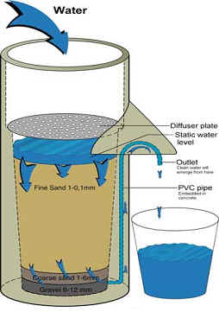
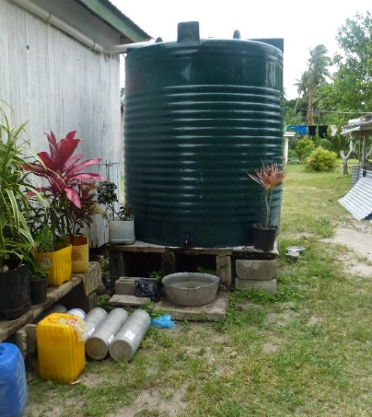
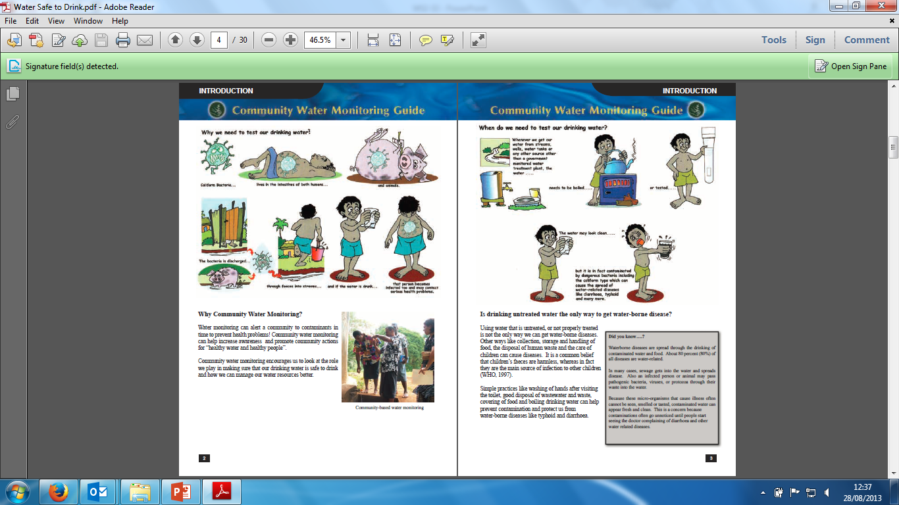
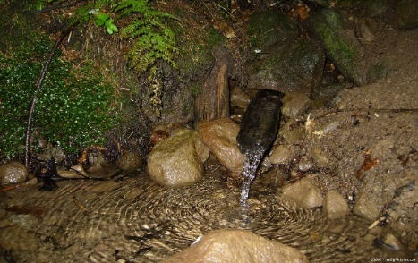
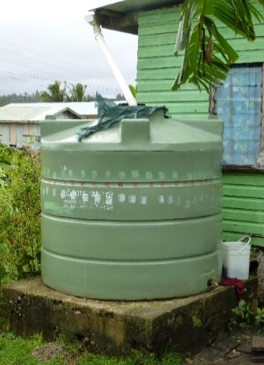
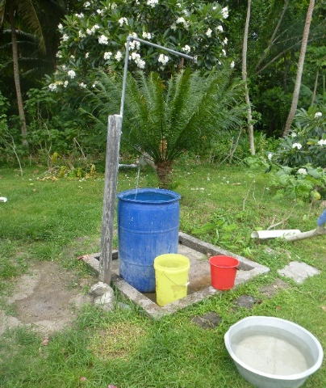
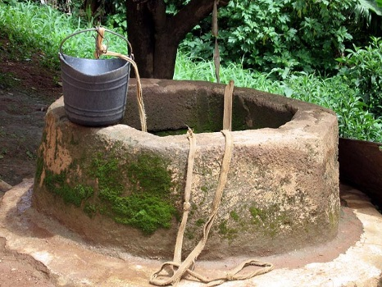
Parts of the Supply – Water System
Catchment / Source
Treatment
Storage and Distribution
Consumer

Slide 4
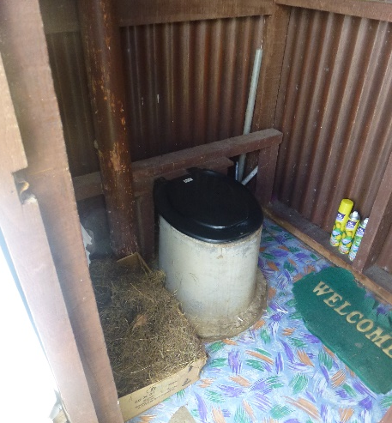
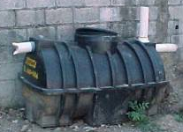
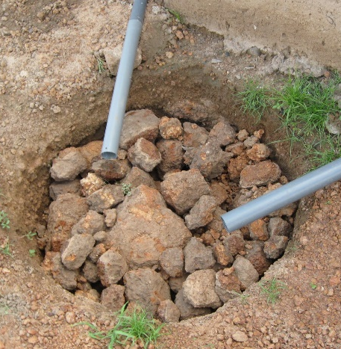
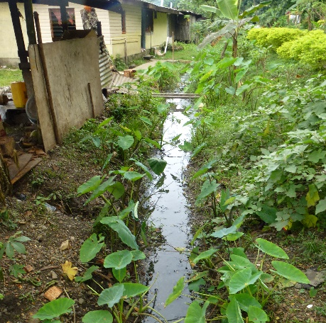
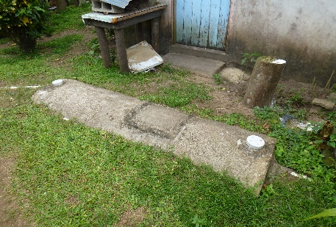
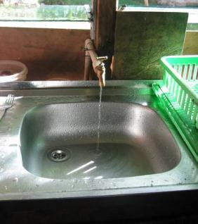
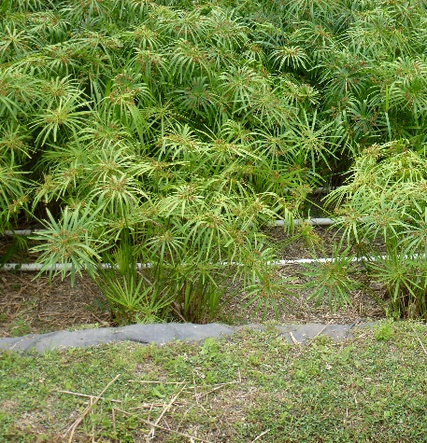
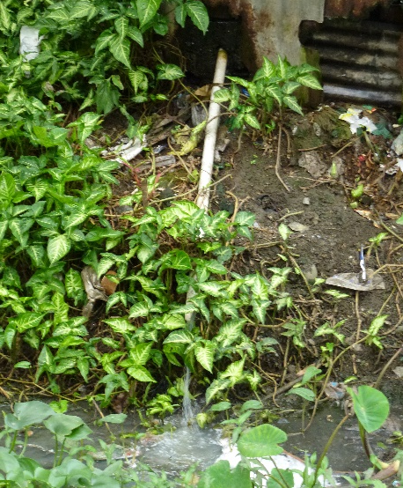
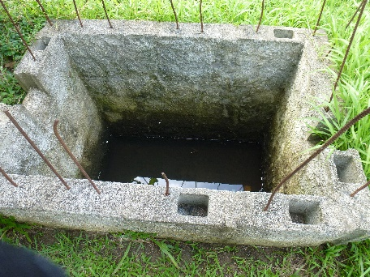
Parts of the Supply – Waste System
Source
Storage & Primary Treatment
Secondary Treatment
Outlet to Environment

Slide 5
What details are required?
Population
No Houses
When Built?
Major Works
Farming Areas
Roads/Crossings
Marine Areas
Land Boundaries
Community Information
Key Parts of Water System
Catchment / Source
Treatment
Storage and Distribution
Source
Storage & Primary Treatment
Key Parts of Waste System
Secondary Treatment
Outlet to Environment

Slide 6
Describe the System Exercise
Step 1. Group Discussion – List all the different parts of your water and waste system
Step 2. Fill in the relevant details in section 2 including drawing a symbol for all parts of your water and waste system
Step 3. Come back and present the result and how they would detail this on the map

Slide 7
System Mapping
Why do system mapping?
They help describe a community and identify assets
Show external agencies information about the village/community
Record and archive information about your water system
Assist in planning for new parts of the system
Increase community understanding

Slide 8
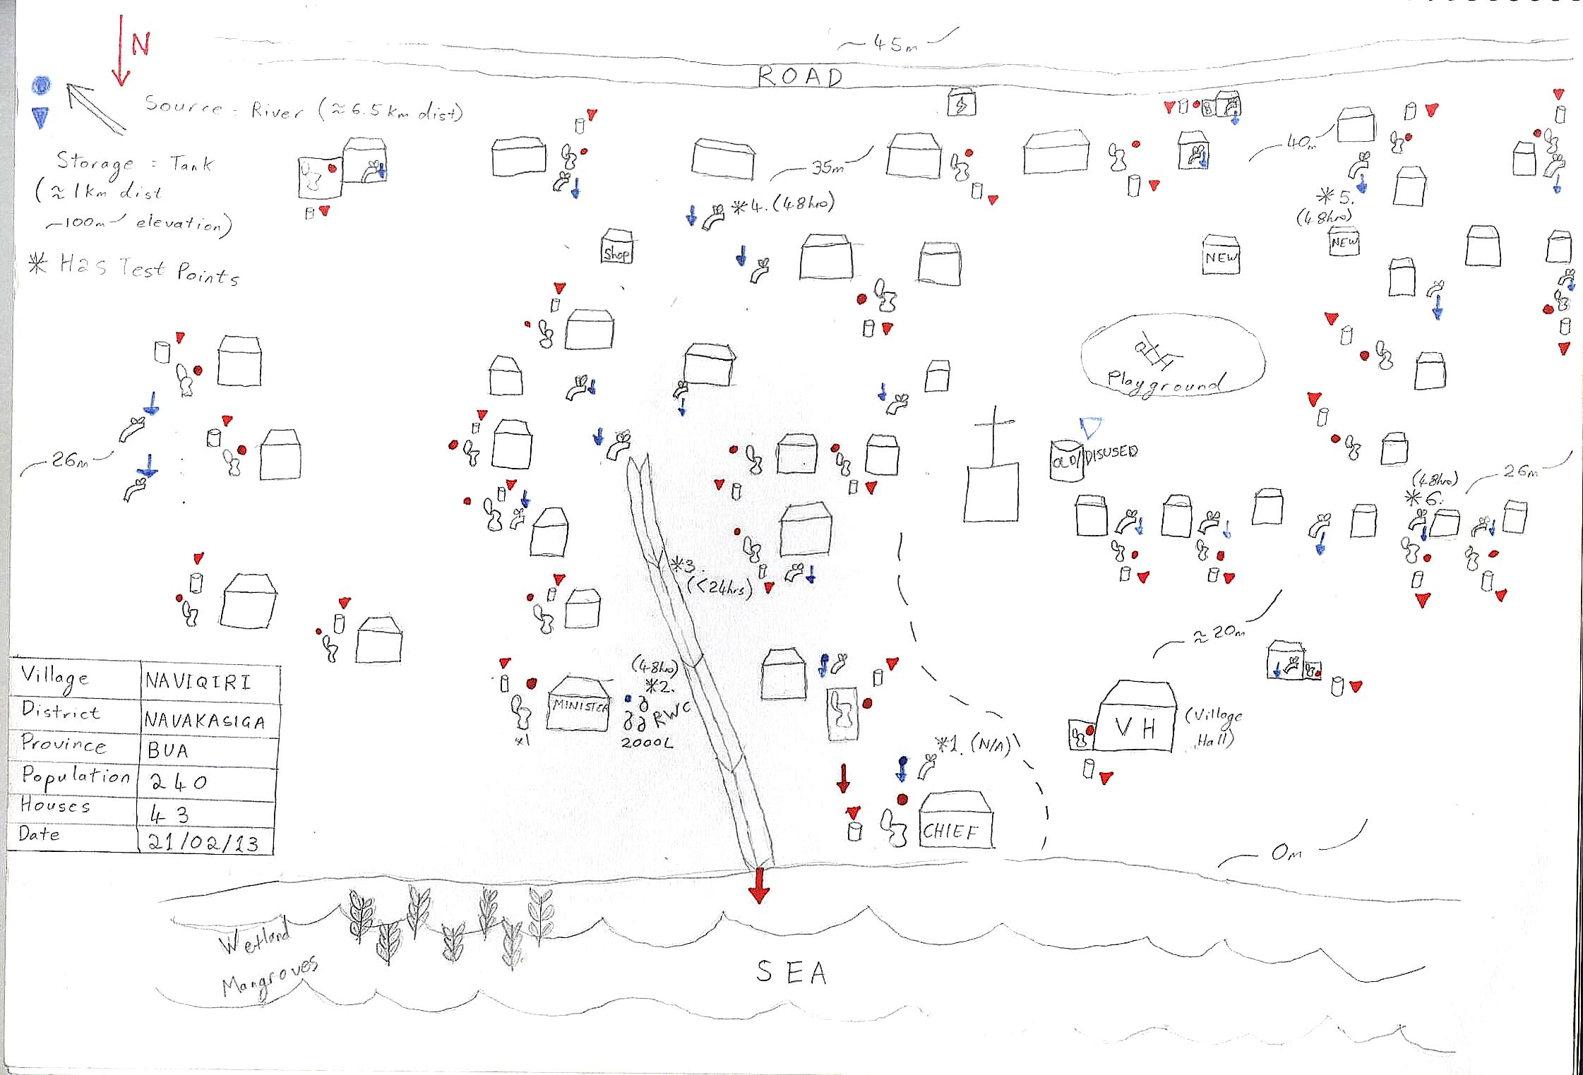
Key Details on a Map
Roads
Location of Water Source and Storage
Distribution Points
Altitude / Height
Houses and Buildings
Village Information
Toilets and Drainage
Marine Areas

Slide 9
System Mapping Exercise
Step 1. Generating the map – Each group to take a walk round the community and make a draft map of the community system using the symbols identified earlier
Step 2. Return to training area and draw up detailed map including village information
Step 3. Present back to the group and compare with other groups maps. Is there enough information?

Slide 10
End of Session

