Slide 1

Drinking Water Safety & Security Planning
Part 2 Implementing DWSSP
Water Safety – An introduction to Safe Water
DWSSP Programme

Slide 2

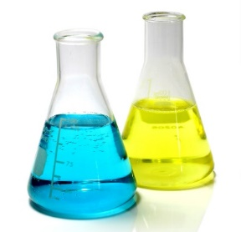

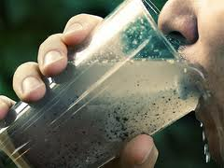
What is Safe Water?
According to the World Health Organisation, Safe Drinking Water is water with microbial, chemical and physical characteristics that meet standards:
Chemical Contamination
Bacteria Contamination
Physical Contamination

Slide 3
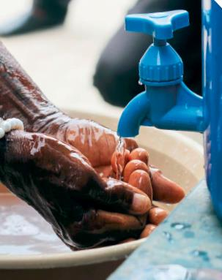
What is Safe Water?
It is defined as the following:
“Safe Drinking Water is free from pathogens and elevated levels of toxic substances at all times”
– WHO/UNICEF Joint Monitoring Programme 2017
It presents no significant risk to health over a lifetime of consumption
That leaves the following question, what are pathogens and what is a toxic substance?

Slide 4
Main contaminants of water
This should be rephrased slightly, what are the main contaminants of drinking water that could be a risk to health
A Pathogen is anything that can cause disease. In water we look at Microbiological Pathogens, ones you cannot see
Bacteria
Viruses
Helminths
Protozoa
A Toxic substance is anything that will cause harm if found in excessive levels. Mainly chemicals.
Fluoride
Arsenic
Nitrate

Slide 5
What are the health effects?
High levels of bacteria may lead to:
Diarrhoea, Intestinal Helminths, Trachoma,
High levels of priority chemical contamination may lead to:
Fluorosis, Arsenocosis,

Slide 6
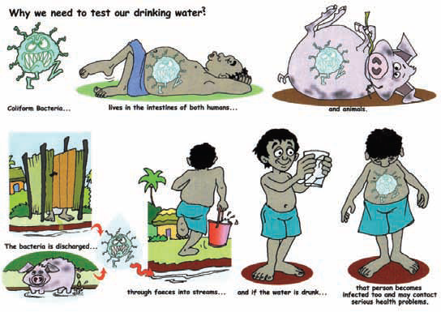
How does the water get contaminated?

Slide 7
How do we know they are in water? – Key Parameters
Parameter | Test | Description | Ideal Reading
Thermotolerant (Faecal) Coliforms |  | Subgroup of coliform bacteria associated with faecal contamination from warm-blooded animals. Can ferment lactose at 44.5ºC during analysis | 0 per 100 mL
E. Coli |  | Indicator of pathogenic (i.e. can result in disease) bacteria found in human intestines | 0 per 100 mL
Total Coliforms |  | Both faecal and non-faecal bacteria from humans, animals and delayed organic matter that are able to ferment lactose at either 35 or 37ºC within 24-48 hours | 0 per 100 mL
Conductivity |  | The measure of a water’s capability to pass electrical flow. A large value indicates a high presence of soluble metals and ions in the water | 1000 μS/cm
Turbidity |  | The cloudiness of water, indicates the amount of solid particles that are suspended in water that can cause the scattering of light | 5 NTU
pH |  | A measure of acidity (low pH) or alkalinity (high pH) of water with a neutral value of 7 | No units

Slide 8
Which are most important?
All are important, but the highest priority is the level of E.Coli in the water. This indicates faecal contamination by either humans or animals (including birds)
High levels of E.Coli mean a higher risk of bacteria and other pathogens being present in the water

Slide 9

How do we measure them? – Water Quality
E.Coli / Total Coliforms – Membrane Filtration
The sample water is passed through a membrane filter, and the coliform bacteria is trapped on the surface. This plate is then incubated to let the bacteria grow before being counted

Slide 10
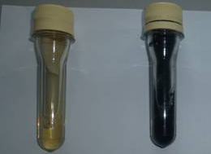
A simple bacteria test – H2S Testing
A simple test where we use colour to determine if the water is good or bad
CLEAR = GOOD
BLACK =
BAD
Main Problem – It doesn’t tell us how contaminated the water is

Slide 11
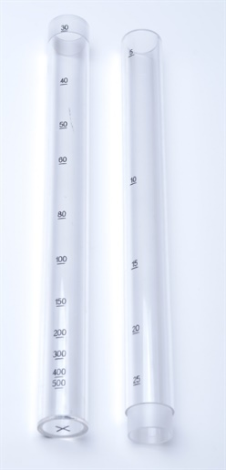
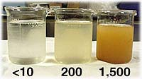
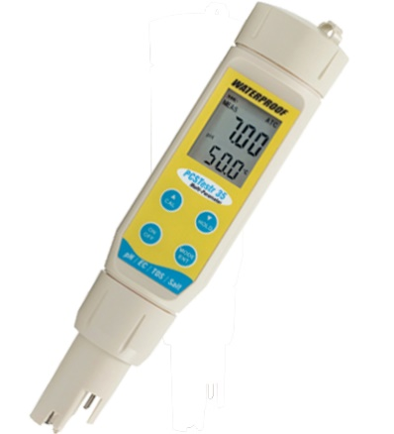
How do we measure them? – Water Quality
Turbidity/Conductivity/pH – Sensors
Turbidity
(How cloudy water is)
Low
High
Conductivity and pH

Slide 12
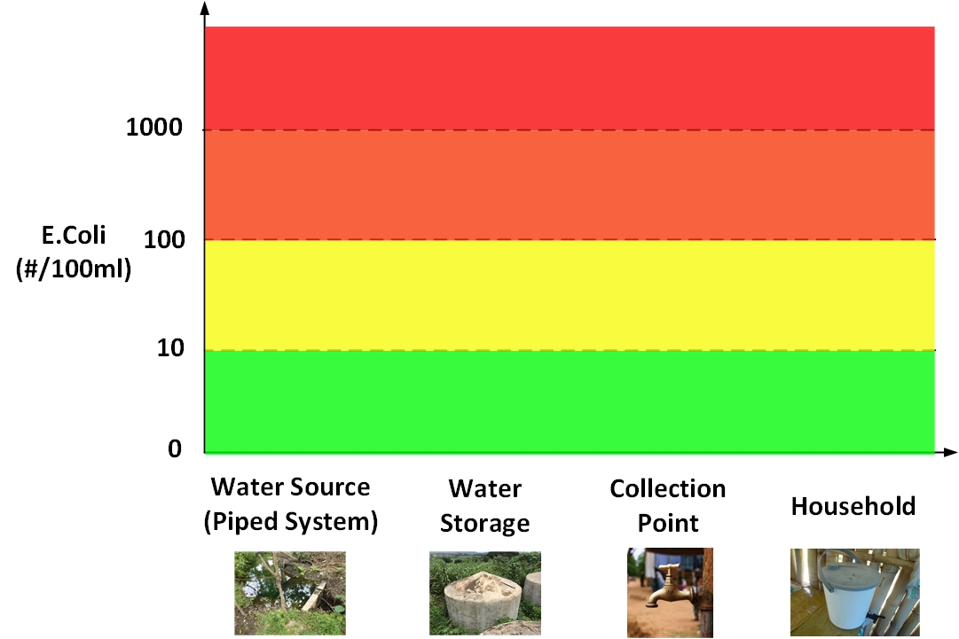
What do we do with the results?

Slide 13
Recommended Actions - Exercise
Water Quality Results
Each group take the results from the testing performed. Plot them on the graph and look at the pattern from the “Water Safety Actions” sheet.
Discuss and present back to the group on the required Water Safety Actions
COMPLETE SECTION 3B WATER QUALITY RESULTS ON DWSSP FOR OWN SYSTEM

Slide 14
End of Session

