Slide 1

Drinking Water Safety & Security Planning
Part 2 Implementing DWSSP
Water Safety – Drinking Water Safety Planning
DWSSP Programme

Slide 2
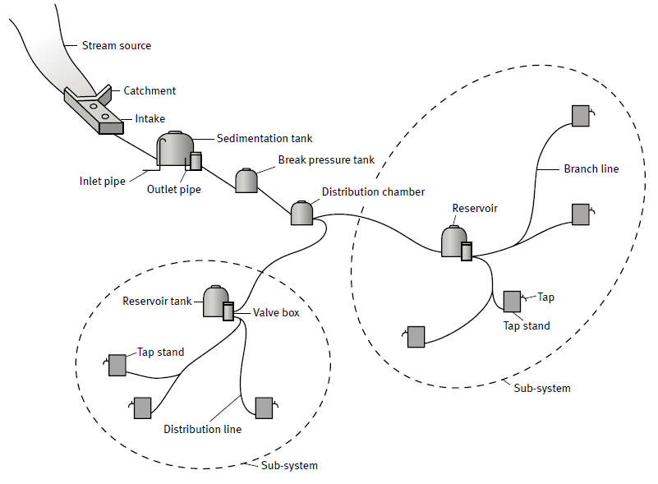
Why Drinking Water Safety Planning?
Imagine this community
Water looks and tastes clean
Steady stream source
Good storage capacity
What could possibly go wrong?
Each home has a tap
Each person has 100 litres per day
WaterAid (2013) Gravity-fed scheme – Tech brief. WaterAid, London.

Slide 3
Why Drinking Water Safety Planning?
Well, the following could……
Water becomes contaminated from a farm upstream
Drought hits hard
We look at Risks to minimise things going wrong!!!!
Storage Tank gets blown over in a storm
Water pressure drops
Population increases
WaterAid (2013) Gravity-fed scheme – Tech brief. WaterAid, London.

Slide 4
DWSP is Risk Management for Water Supplies
DRINKING WATER SAFETY PLANNING
“The most effective means of consistently ensuring the safety of a drinking-water supply………
is through the use of a comprehensive risk assessment and risk management……..
approach that encompasses all steps in the water supply from catchment to consumer.”
PREVENTING CONTAMINATION OF THE DRINKING WATER SUPPLY AND MANAGING RISKS

Slide 5


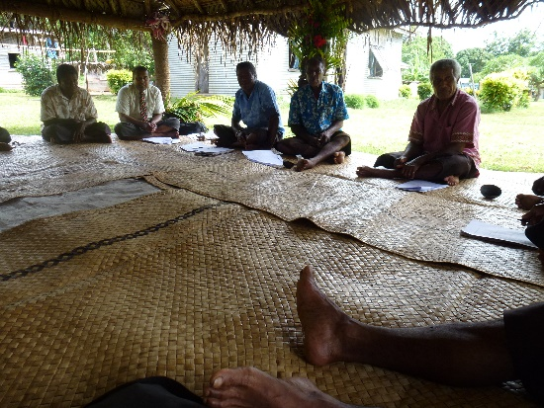
What is Risk Management?
Risk Management is a Process of:
Identifying Risk
Assessing and Prioritising Risk
Planning to Minimise Risk

Slide 6
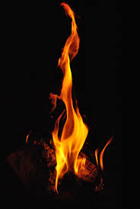
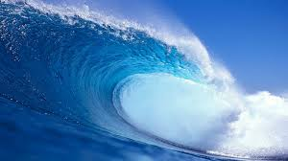
What is Risk?
Risk is made up of many things
Hazards
Sources of danger
Control Measures
Drinking Water Supply
HAZARD
Control Measure
Control Measure
Stops Hazards causing harm
Control Measure

Slide 7
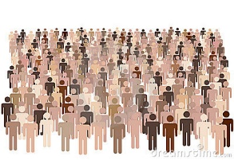
What is Risk?
Risk is the likelihood (or chance) of a hazard causing harm
Hazard
Hazard
Hazard
Control Measure
Hazard
Hazard
Hazard
Control Measure
Hazard
Hazard
HIGH RISK
Control Measure
Control Measure
Hazard
Control Measure
Control Measure
Control Measure
Hazard
Control Measure
LOW RISK

Slide 8
Steps in a Risk Assessment
A simple risk assessment can boil down to only a few questions:
What can go wrong/cause harm?
What is the chance of it happening? How bad?
Hazard Identification
Risk Analysis
How can we minimise the chance of it happening?
Risk Management

Slide 9
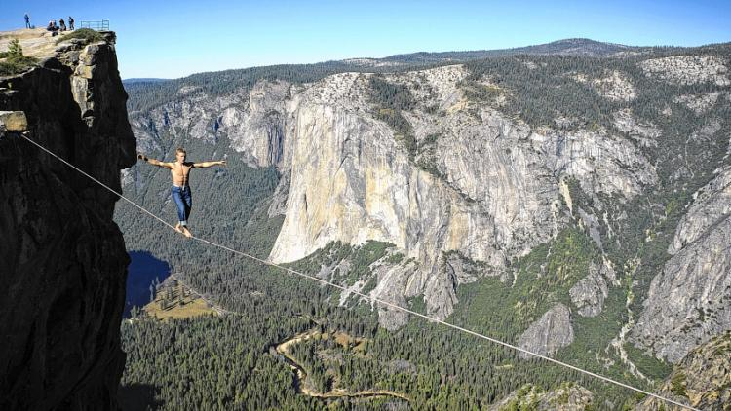
Risk Assessment Example

Slide 10
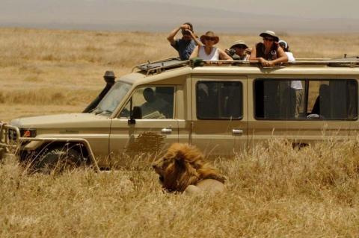
Risk Assessment Example

Slide 11
Hazard Identification – Exercise
What do you think can go wrong in a Drinking Water Supply?
Split into groups and discuss
Present back to group what you think can go wrong with Drinking Water

Slide 12
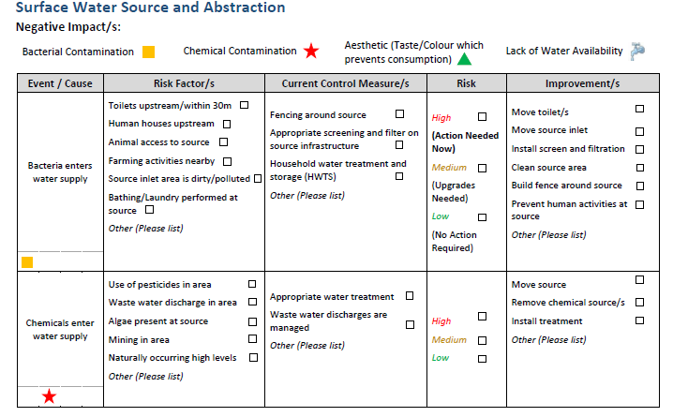
Risk Assessment Steps for DWSP
A
A. Identify area of the system
B
B. Understand what can go wrong
C
C. List the events that could lead to this
D
E
F
G
D. For each event, identify the risk factors
E. Then identify the CURRENT control measures
F. Evaluate the Risk of the event occurring
G. Plan to minimise the event occurring

Slide 13
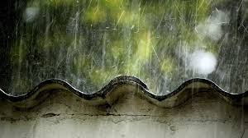
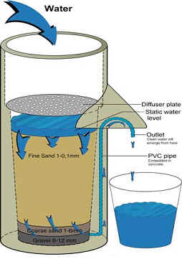
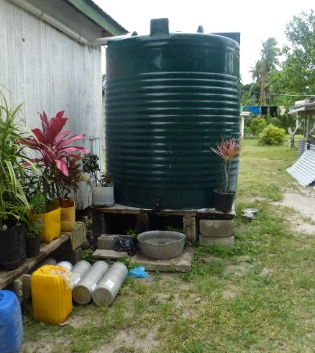
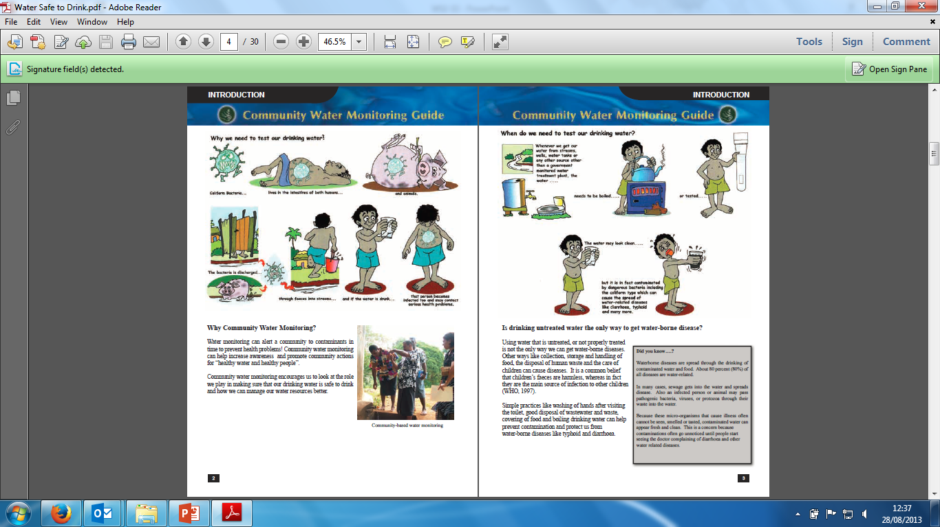
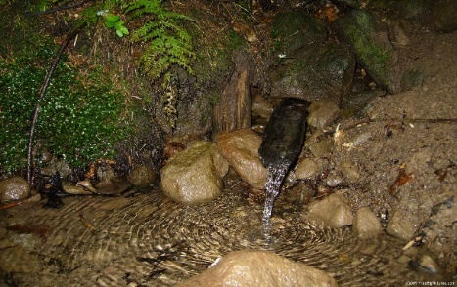
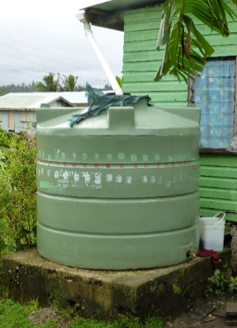
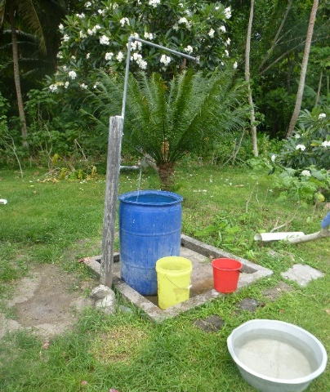
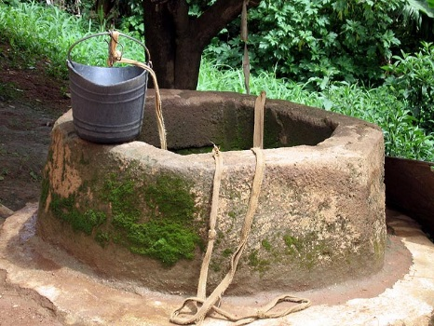
A. Identify the area of the system
Catchment / Source
Treatment
Storage and Distribution
Consumer

Slide 14
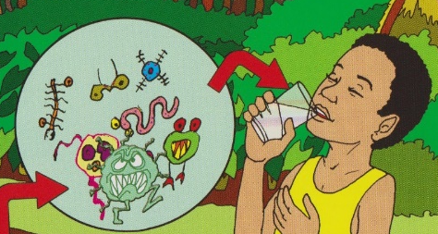
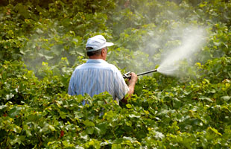
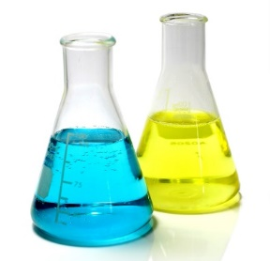

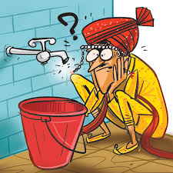
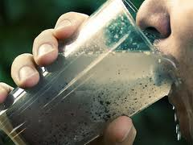

B. What can go wrong with drinking water?
There are 4 main problems we encounter with the provision of drinking water: What are they?
Bacteria Contamination
Chemical Contamination
No Water Available
Aesthetic (Unpleasant to Drink)

Slide 15
C. What events cause problems?
The main events that cause problems include:
Bacteria enters Drinking Water Supply
Chemicals enters Drinking Water Supply
Dirt/Soil/Solids enter the Drinking Water Supply
Drinking Water Supply flow is uncontrolled
Disaster or Climate Change effects including:
Drought
Flooding (Fresh or Salt Water)
Storm Damage
Earthquake

Slide 16
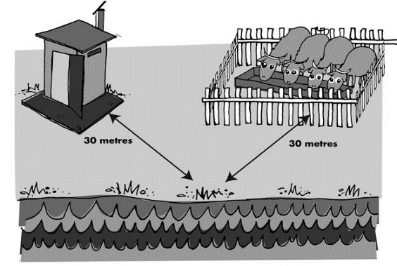
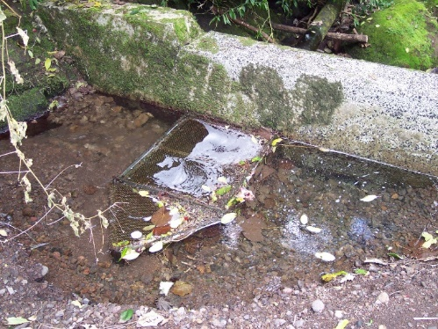
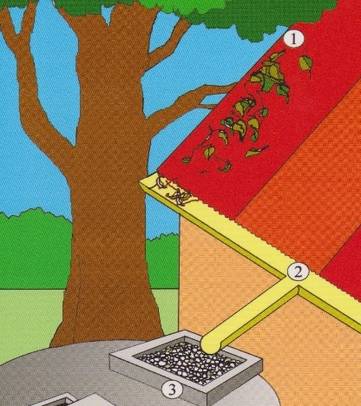
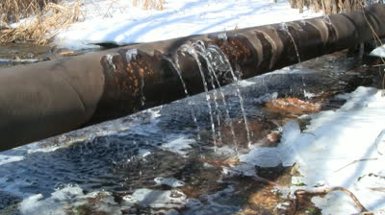
D. What are the Risk Factors for each event?
Bacteria enters Drinking Water Supply
Water Source | Water Distribution System
Toilets and Animals Near Water
Animal Access
Cracks and Leaks – Ingress
Dirt or Rubbish

Slide 17
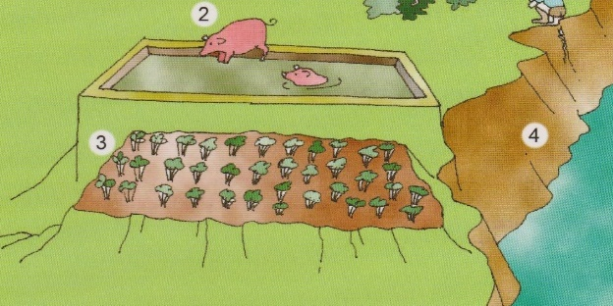
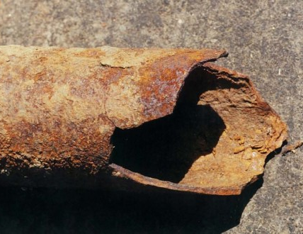
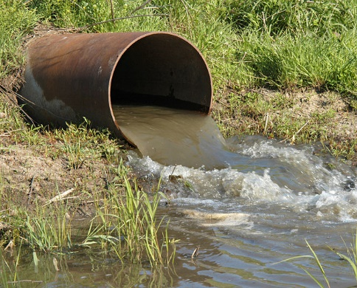
D. What are the Risk Factors for each event?
Chemicals enters Drinking Water Supply
Water Source | Water Distribution System
Farming/ Pesticides
Waste Water Output
Corrosion

Slide 18
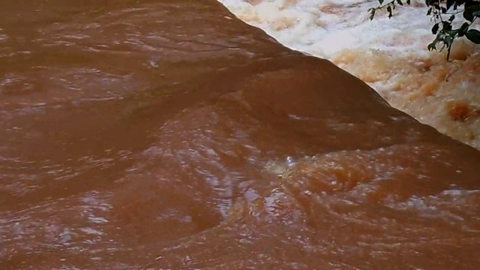
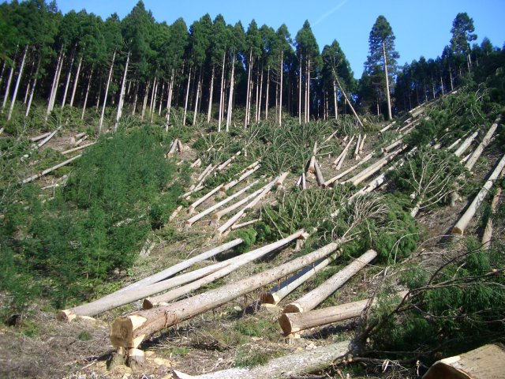
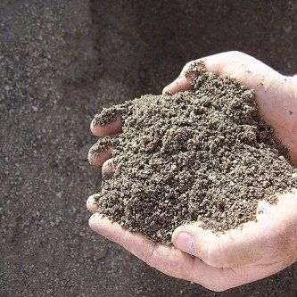
D. What are the Risk Factors for each event?
Dirt/Soil/Solids enter the Drinking Water Supply
Water Source | Water Distribution System
Soil Erosion/ Surface Runoff
Leaking Pipes
Deforestation
Unconsolidated Soil

Slide 19

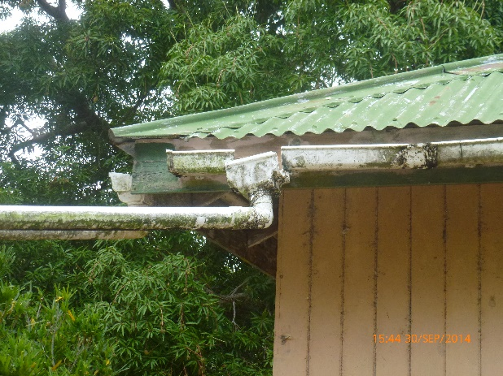
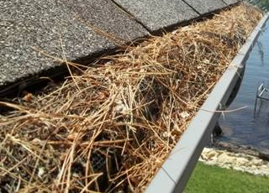
D. What are the Risk Factors for each event?
Drinking Water Supply flow is uncontrolled/ Drought
Water Source | Water Distribution System
Variable/ Low water levels
Leaks
Damaged Collection Structures
Blocked Piping

Slide 20
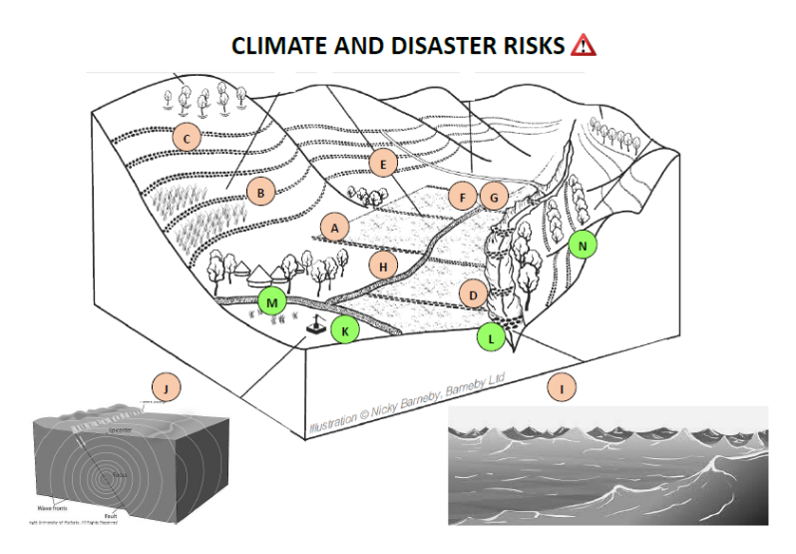
D. What are the Risk Factors for each event?
Disaster/ Climate Change Effects
Low level Flood Plain
(Flooding)
Base of Slope
(Landslide)
Near River
(Flooding)
Near Gully
(Subsidence)
Earthquake Zone
(Earthquake)
Near the shoreline
(Tsunami/King Tide)

Slide 21

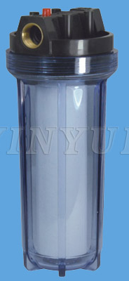
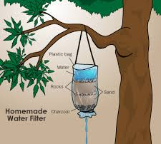

E. Control Measures – Bacteria/Chemical
Fencing around a source
Mesh Inlet Screen
Filters – Gravel or Sand

Slide 22
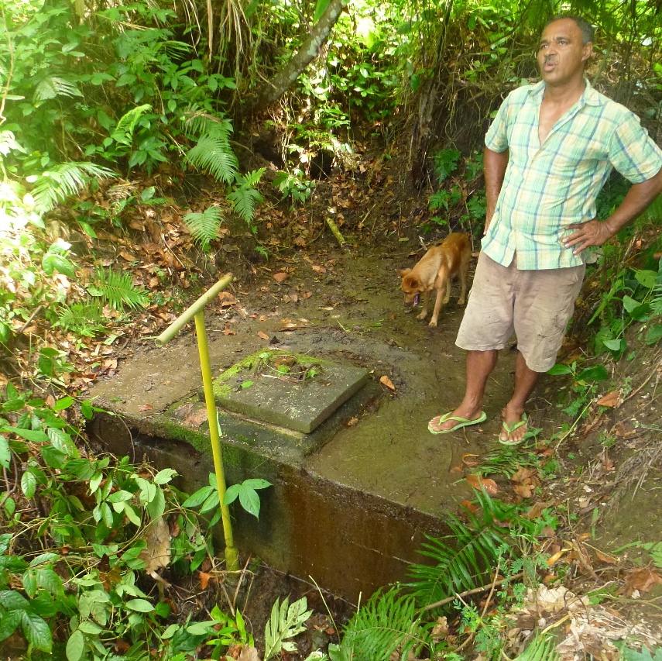
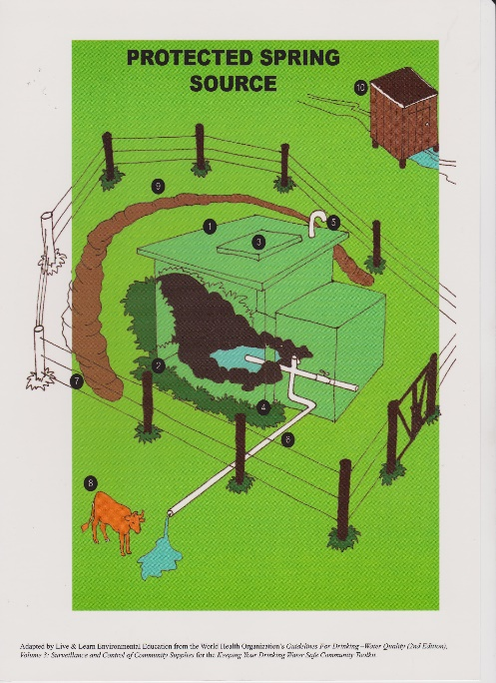
E. Control Measures – Bacteria/Physical
Spring Box
Covering a source
Diversion Ditch
Overflow Pipe

Slide 23
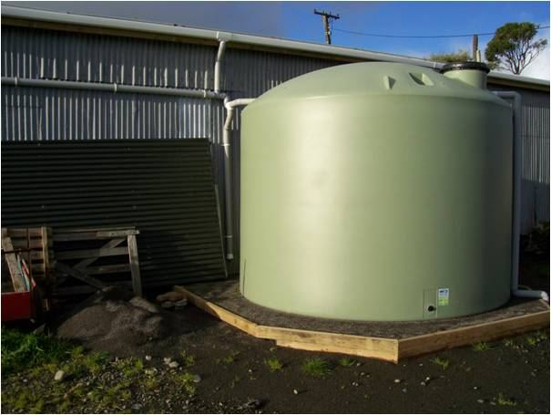
E. Control Measures – Bacteria/Physical
Sealed Cover
Clean with no leaks
Solid Base

Slide 24
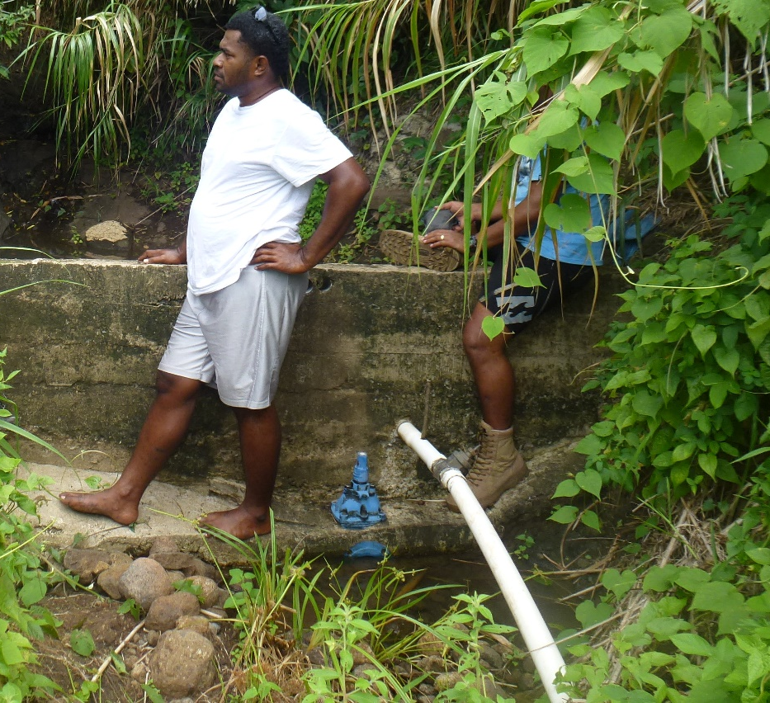
E. Control Measures – Controlling Flow
Min Head Device e.g. Dam
Overflow Pipes
Pressure Break Box

Slide 25
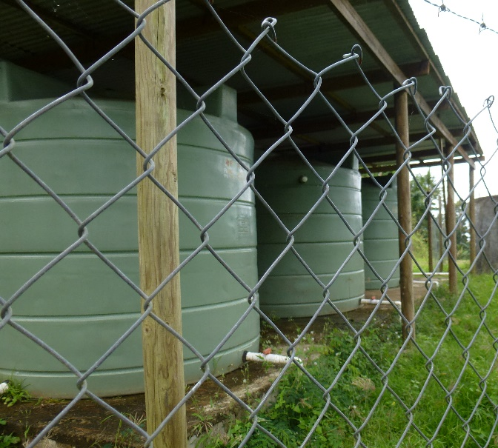
E. Control Measures – Treating Water
Storage and Settlement
First Flush Rainwater
Filters

Slide 26
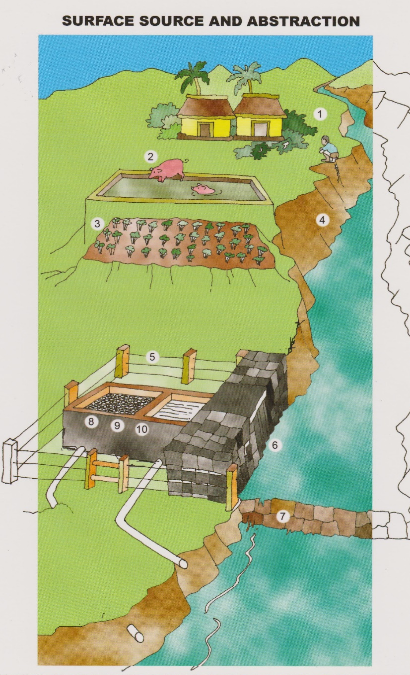
D&E. Best Practice – Surface Sources
Reduce use of fertilisers near catchments
Establish drinking water protection zones (Fencing)
For surface: Install and maintain screens and sediment traps

Slide 27

D&E. Best Practice – Spring Sources
Keep toilets and septic tanks 30m away from source
Protect source against run off flows (Diversion Ditch)
For spring: Construct a safe collection chamber
Prevent roaming of animals near the source (Fence)

Slide 28
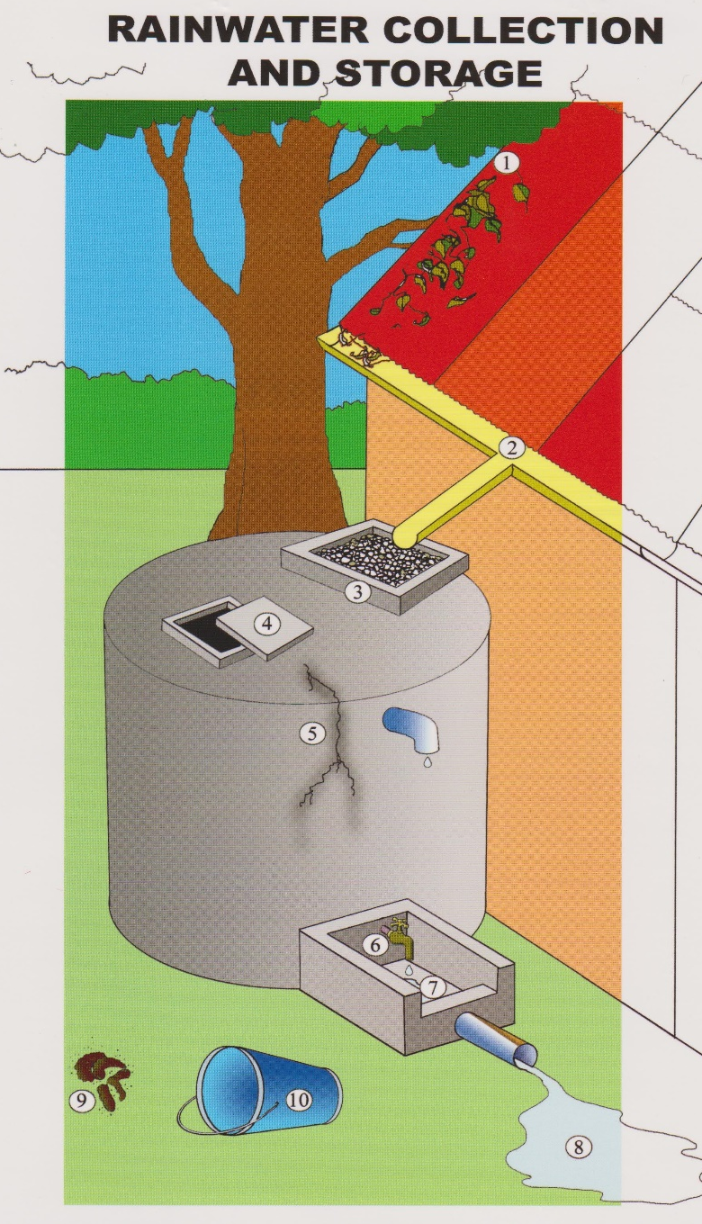
D&E. Best Practice – Rainwater Collection
Keep collection roofs clean
Put inlet screens on tanks
Regular cleaning, inspection and maintenance of storage
Repair leaks and cracks to avoid contaminant ingress
Keep Collection areas clean

Slide 29
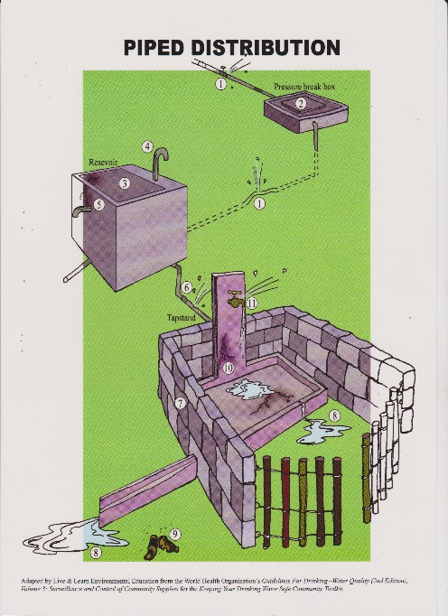


D&E. How to identify risks and control measures
With so many Events how can we identify Risk Factors and Control Measures on our system?
Main Tool for Risk Factor and Control Measure Identification
SANITARY SURVEYS

Slide 30
Identifying Risks and Control Measures - Exercise
Supply/Storage Hazards and Control Measures
1 Group perform Sanitary Survey for the Water Source
Distribution Hazards and Control Measures
1/2/3… Group/s perform Sanitary Surveys on Distribution Points
Present back to group on risk factors and control measures for the water system
Tick the relevant boxes. Are there any more that need listing?
COMPLETE RISK FACTORS AND CURRENT CONTROL MEASURES COLUMN ON TEMPLATE

Slide 31
F. Evaluating/ Ranking Risk
We have 3 levels of Risk
What this means
Action needed
HIGH
The system is not secure and the chances of contamination are high
Improvements needed now
MEDIUM
The system has some protection but still could get contaminated
Improvements are needed but not immediately
LOW
The system is well protected with a low chance of contamination
No action required but must be monitored

Slide 32
F. Evaluating/ Ranking Risk
How do we calculate our level of Risk?
HIGH
Hazard
Control Measure
Hazards present
No Control Measures
Hazard
Control Measure
Hazard
Control Measure
Control Measures present
Hazards present
AND
MEDIUM
Hazard
Control Measure
Hazard
No Hazards
Control Measure
No Control Measures
AND
Hazard
Control Measure
LOW
Hazard
Control Measure
Control Measures present
No Hazards
Hazard
Control Measure

Slide 33
Evaluating/ Ranking Risk – Exercise
Look again at your answers for your water system
Calculate the risk for each Hazard Event on each part of your water system
Present back to the group on the level of risk within the water system
COMPLETE RISK COLUMN ON TEMPLATE

Slide 34
G. Improve/ Manage Risk
Why improve?
HAZARD
Drinking Water Supply
Control Measure
Control Measure
Control Measure
The more barriers we have the better we can minimise the risk to the supply
So how do we improve?

Slide 35
G. Improve/ Manage Risk
We can improve/ manage risk in 2 ways:
1. Decrease the number of Hazards/ Risk Factors
2. Increase the number of Control Measures
Hazard
Control Measure
Control Measure
Hazard
Control Measure
Hazard
Hazard
Hazard
Control Measure
Control Measure
Hazard
Hazard
Hazard
Control Measure
Control Measure

Slide 36

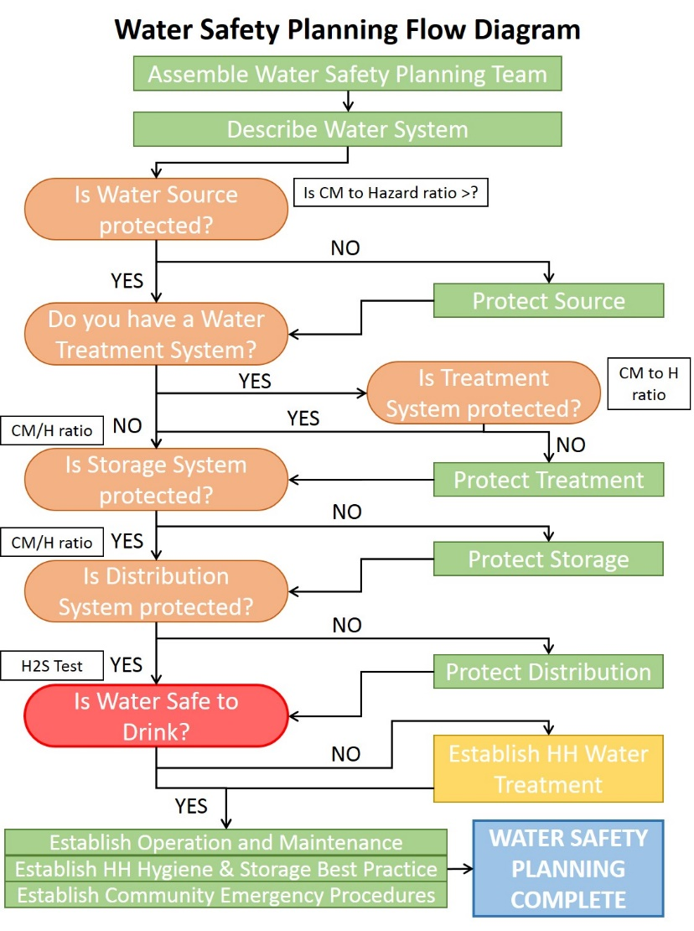
G. Improvements Required?
How can we decide what improvements are needed?
DECISION FLOW DIAGRAMS
OR
OUR OWN IDEAS

Slide 37
Identifying Improvements – Exercise
Run Flow Diagram (Decision Diagram) exercise using posters
Each group to tick required improvements or list additional or more relevant actions
COMPLETE IMPROVEMENTS COLUMN ON TEMPLATE

Slide 38
End of Session

