Slide 1

Drinking Water Safety & Security Planning
Part 2 Implementing DWSSP
Planning for Adequate Sanitation
DWSSP Programme

Slide 2
What is a Water Secure community?
Water Security is complicated, but we believe a Water Secure community has 3 things:
Has reliable access to enough water quantity of good enough quality for drinking and human well being inclusive of sanitation and hygiene
Has adequate sanitation provision, and collects and treats waste water in order to protect humans and the environment from pollution
The ability to cope with uncertainties and risks of water-related hazards, for normal operation, disaster scenarios and long term changes

Slide 3
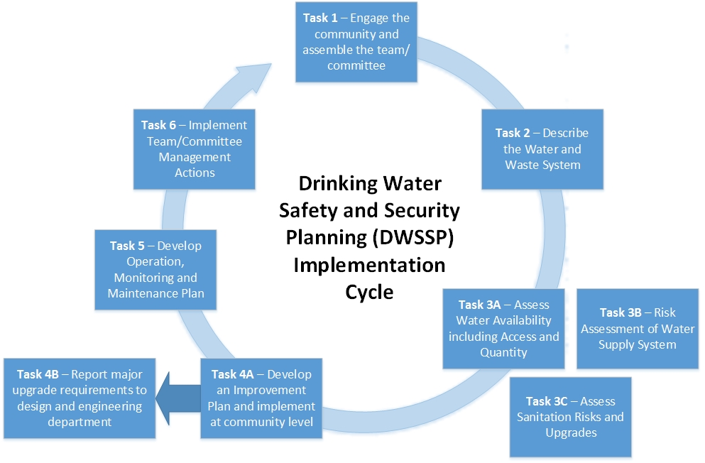
DWSSP Programme

Slide 4
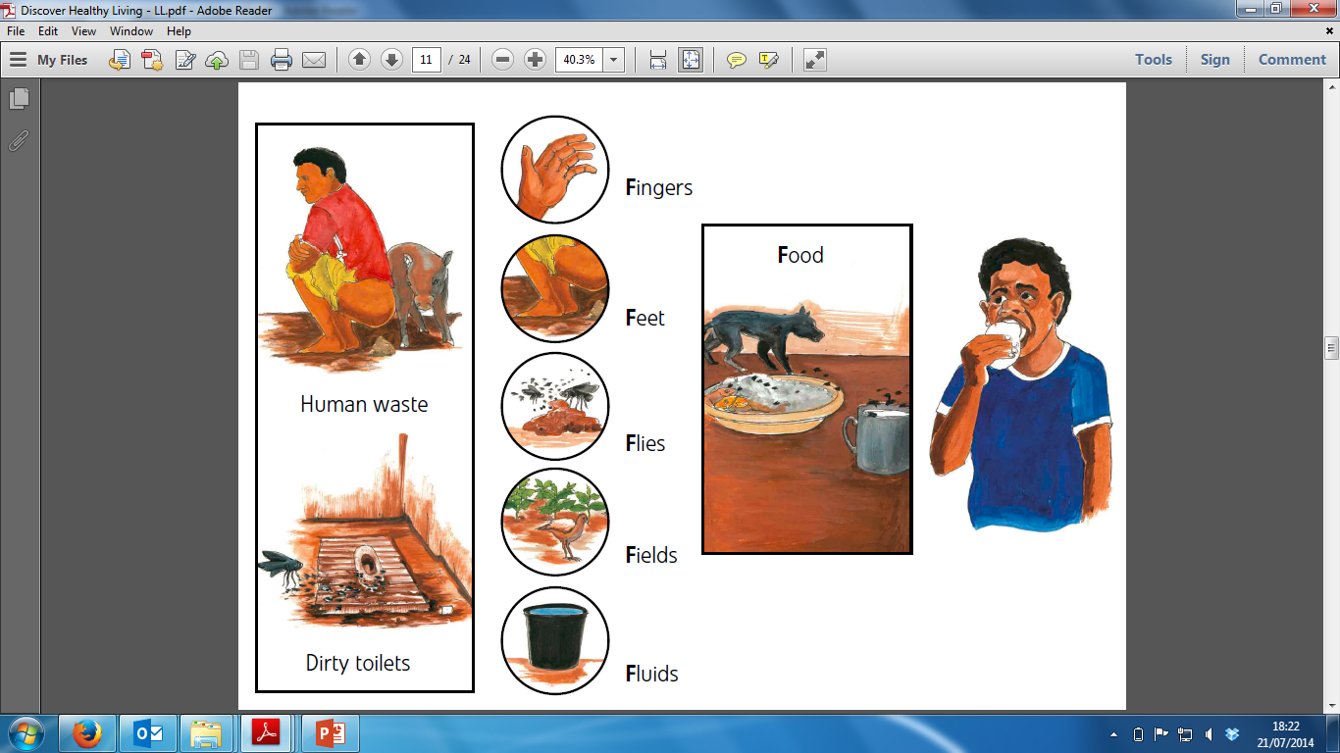
Adequate Sanitation – First defence
Good Sanitation
Clean Water
Hygiene
Hygiene

Slide 5


What do we want Sanitation to do?
Hygienically preventing contact of waste to humans via the following
Through the food chain
Human Waste
Through the environment and drinking water

Slide 6
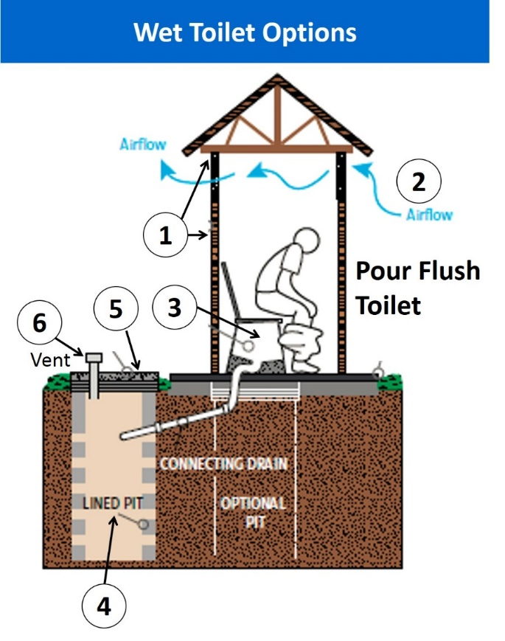
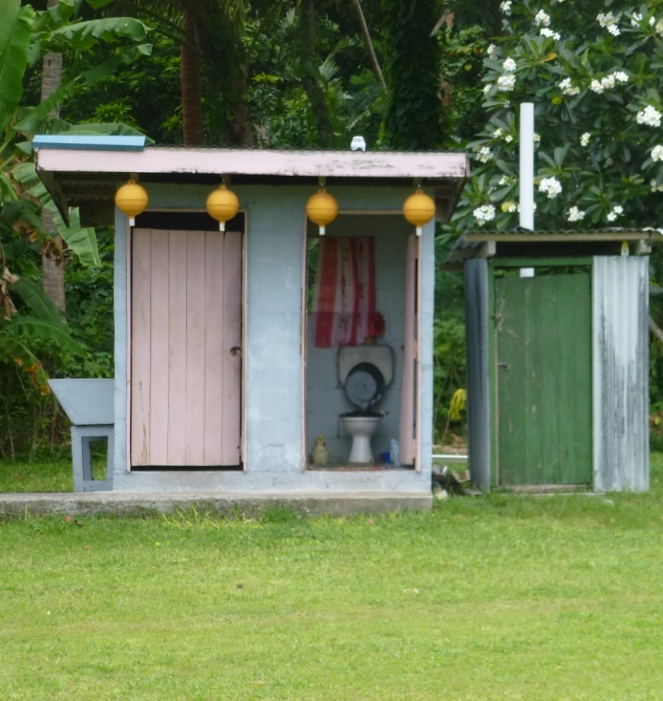
What is adequate sanitation?
ADEQUATE SANITATION is where the proper facilities exist for safe and dignified disposal of human faeces and urine. Human behaviour and practices are also key to this.
1. Good Shelter Structure
2. Good Ventilation
3. Clean Toilet Pan
4-6. Waste is stored or disposed of safely
7
7. Hand Washing is available

Slide 7
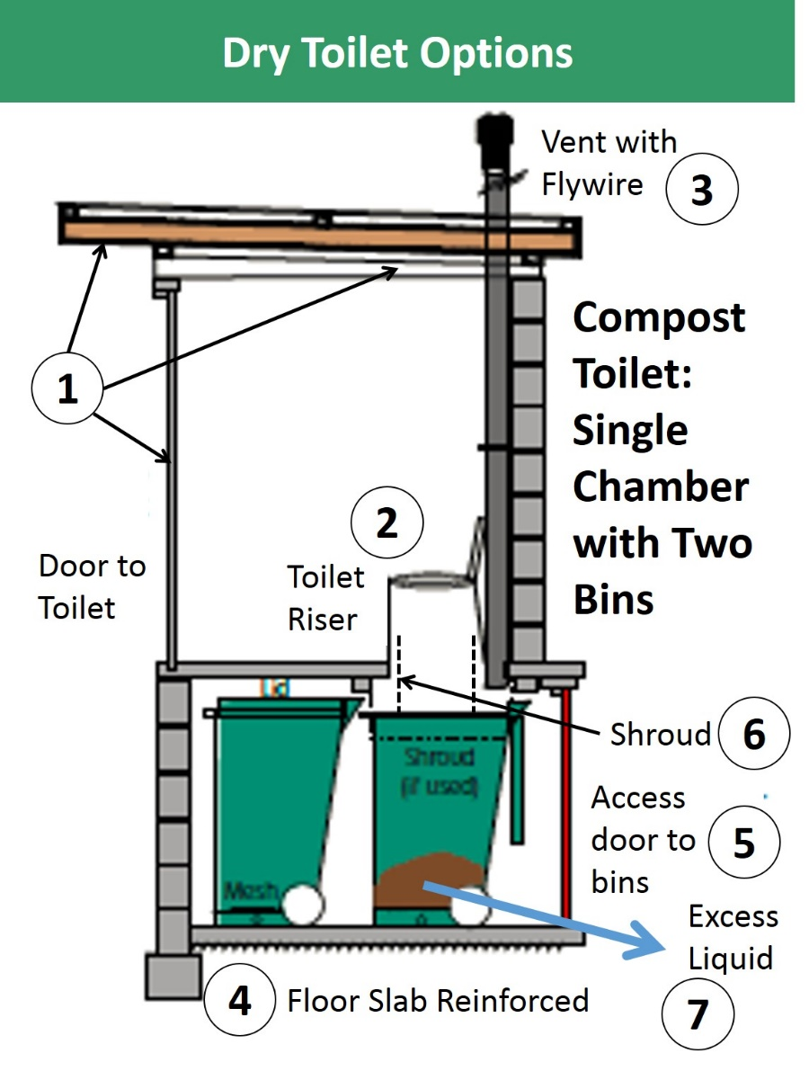
Types of Sanitation
Toilets – Common Types
Dry Types
Compost Toilets or Pit Latrines
No Water Used
Good for saving water in village but needs maintenance

Slide 8

Types of Sanitation
Toilets – Common Types
Wet Types
Pour Flush Toilets
or Flush Toilets
Water Used
Easier to clean/maintain but does require water

Slide 9
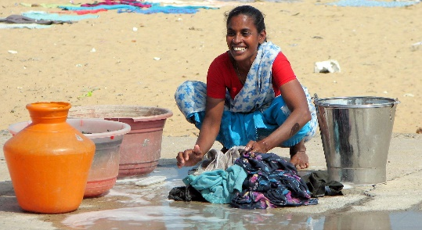
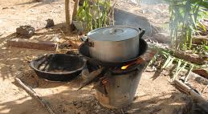
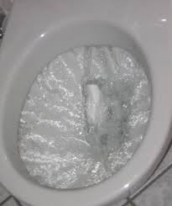
Waste Water Types
Different Types of Waste Water
Waste Water from washing, laundry and cooking
NO HUMAN WASTE
Grey Water
Waste Water from toilets
WITH HUMAN WASTE
Black Water

Slide 10
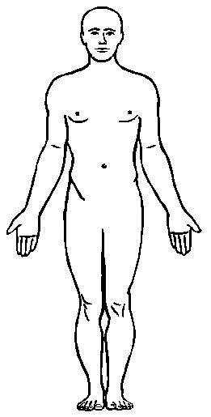
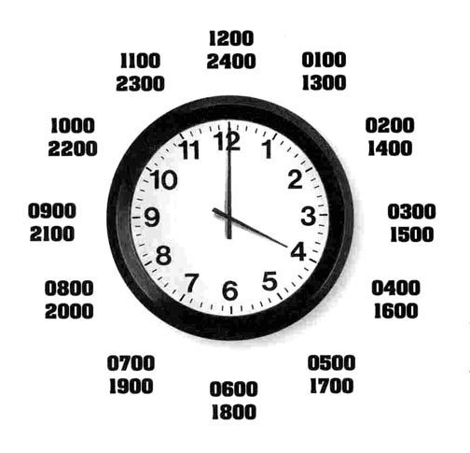

Waste Water Amount
How much black water do we generate?
per
per
N Litres
2 litres – Dry Toilet
10 litres – Wet Toilet
1 Person
1 Day
All Black Water Should be Treated

Slide 11
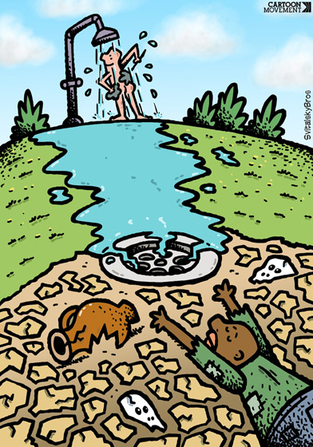


Waste Water Amount
How do we calculate?
Population Number
x
N Litres
=
Total Number of Litres Per Day
EXERCISE – Calculate requirements for community now in groups (10mins). Discuss waste storage requirements.

Slide 12

How many toilets are adequate?
Toilets – How many are required?
Requirements
Are within 250m of dwellings (2-3mins)
Household to
Toilet Ratio = 1:1

Slide 13


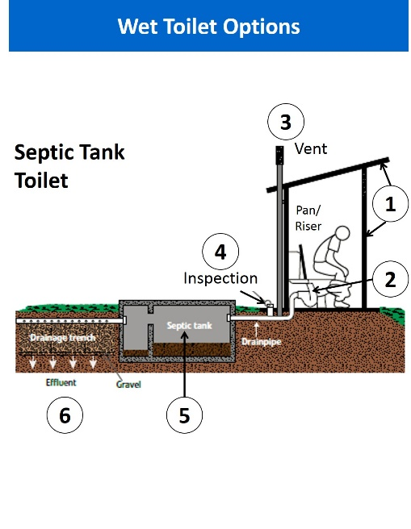
What is an adequate toilet?
How good are your toilets?
The standard of the current toilets is important when assessing water security
Main Tool for Assessing Toilet Standards?
SANITARY SURVEYS

Slide 14
Waste System Requirements - Exercise
Toilets
Each Group fill out the number of toilets they have in their community
What is the ratio of HH to Toilets? Fill in Section 2
Condition of Toilets
1/2/3… Group/s perform Sanitary Survey for all the toilets in the village where possible. What is the condition? How many need upgrading?
COLLATE ALL EXERCISE INFORMATION. COMPLETE SECTION 3C IN DWSSP

Slide 15
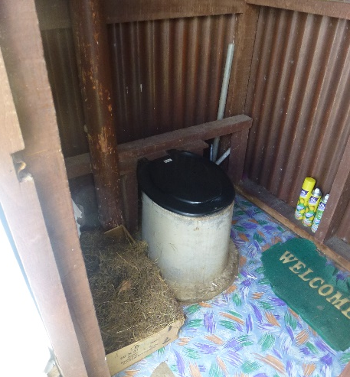
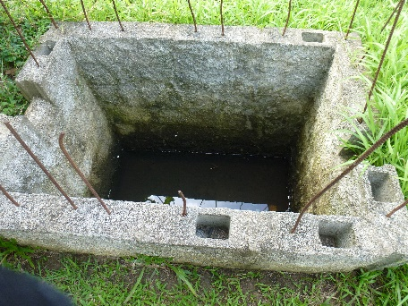
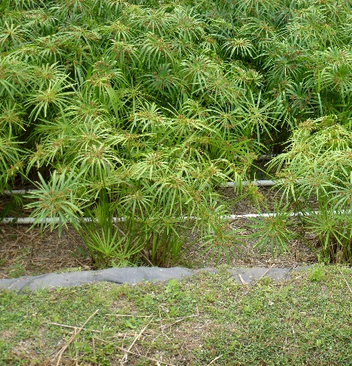
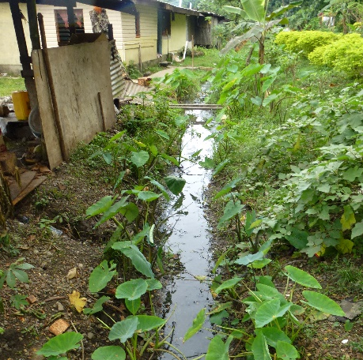
Waste System Design
What are the key parts of a waste system?
Storage and Primary Treatment
Source
FOCUS WILL BE TOILETS
Secondary Treatment
Outlet to Environment

Slide 16
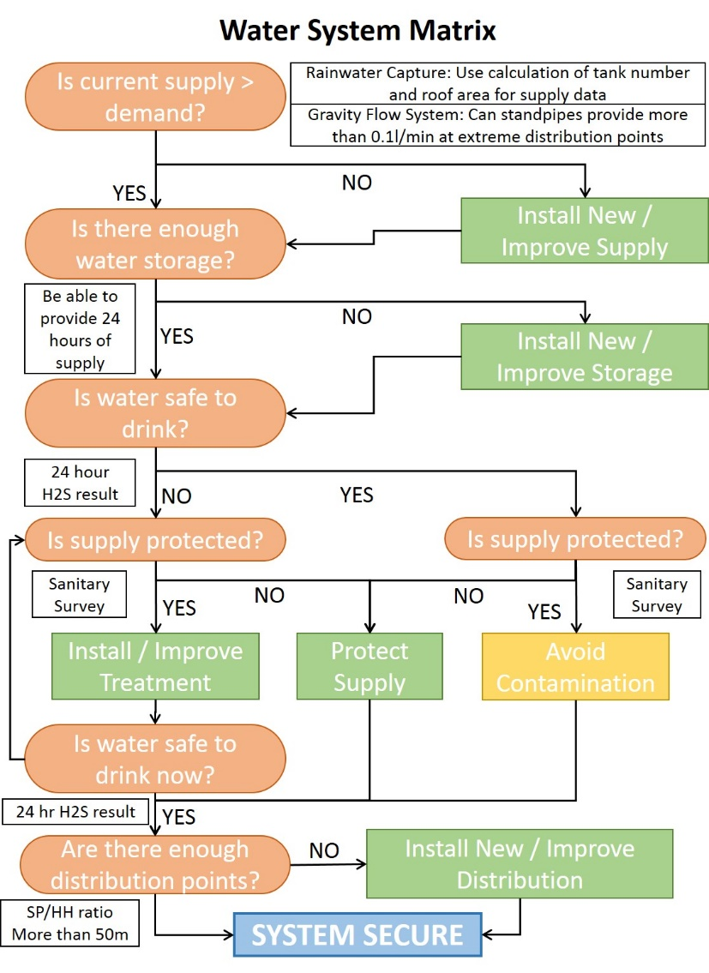
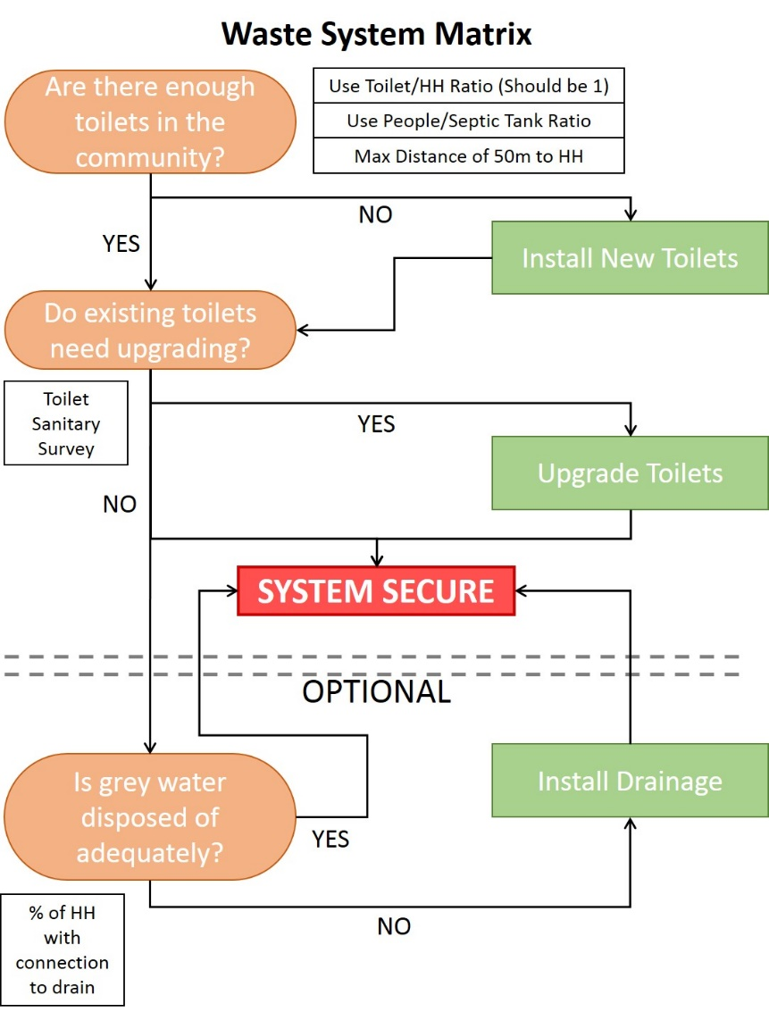
Waste System Design
How do we design the system?
DECISION FLOW DIAGRAMS

Slide 17
Waste System Design – Toilets
Toilet Options – Compost Toilet
Dry toilet that uses no water for flushing. All waste is captured within a closed chamber
Advantages:
Almost no water needed
Does not pollute groundwater
Can be located anywhere
Compost can be used on soil for agriculture
Clean and hygienic

Slide 18
Waste System Design – Toilets
Toilet Options – Compost Toilet continued
Disadvantages:
Organic matter (e.g. grass) must be regularly collected and stored in the toilet
Users need to understand and control the addition of grass
Can be expensive
Users have to empty waste from collection chamber twice a year
Access can be difficult

Slide 19
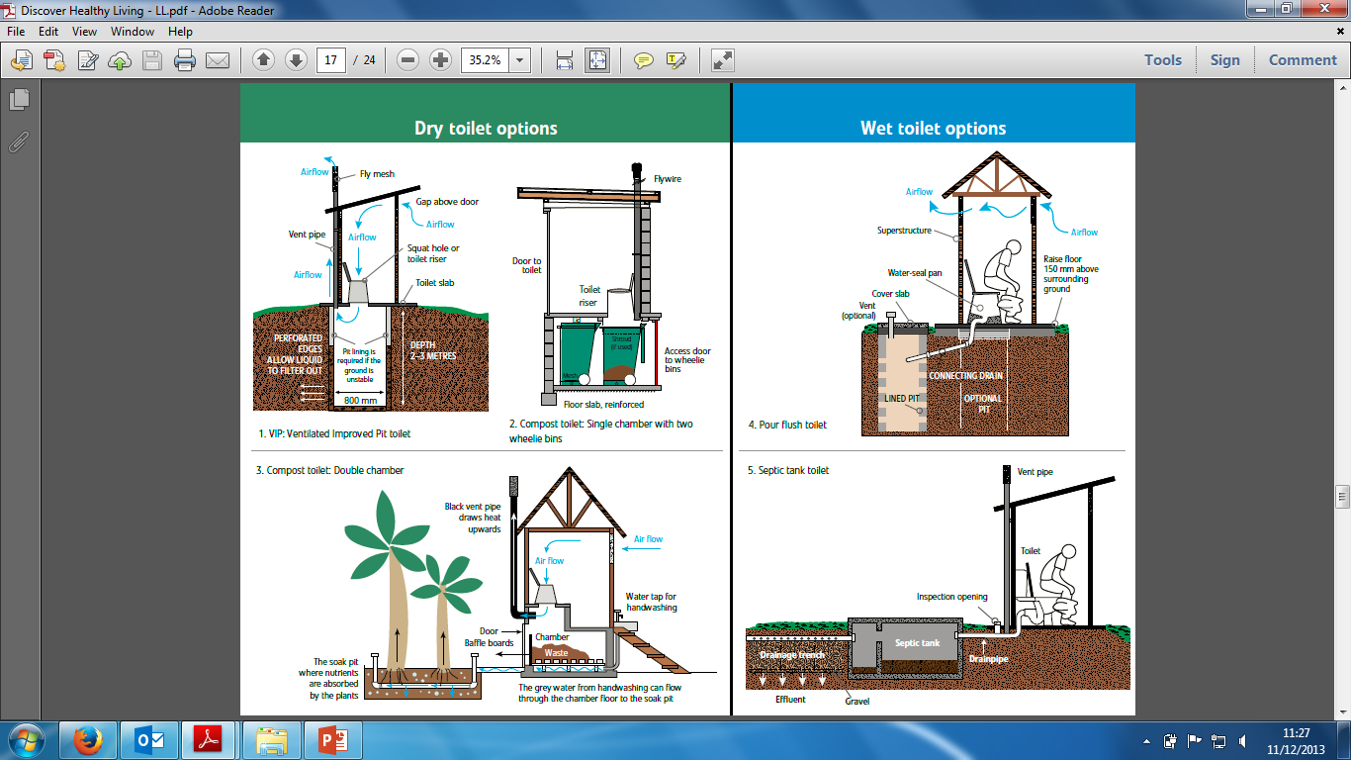
Waste System Design – Toilets
Toilet Options – Pour Flush Toilet
Like a regular flush toilet only water is poured by the user using a bucket
Advantages:
Low cost
Can control flies and mosquitos
Absence of smell
Low water use
Can be upgraded easily e.g. connected to sewer

Slide 20
Waste System Design – Toilets
Toilet Options – Pour Flush Toilet continued
Disadvantages:
Reliable water supply needed
Potential for groundwater pollution
Need to move toilet if new pit is dug

Slide 21
Waste System Design – Toilets
Toilet Options – Flush Toilet with Septic Tank
Advantages:
Convenience and status
No smell or insects
Can be located in a house
Easy to Clean
Toilet where waste is flushed into sealed septic tank

Slide 22
Waste System Design – Toilets
Toilet Options – Flush Toilet with Septic Tank cont
Disadvantages:
Expensive
Needs reliable and adequate water supply
Not suitable if small area for outflow
Can pollute groundwater if high water table or outflow is poorly designed
Needs expensive septic tank collection occasionally
High cost to maintain

Slide 23
Waste System Design – Toilets
Are there enough toilets in the community?
Use Toilet/HH Ratio (Should be 1)
Use People/Septic Tank Ratio
Max Distance of 250m to HH
NO
YES
Install New Toilets
Do existing toilets need upgrading?
Are there enough toilets in the community?
Use Sections 1 & 2 data to answer
IF NO SEE “INSTALL NEW TOILETS” MATRIX

Slide 24
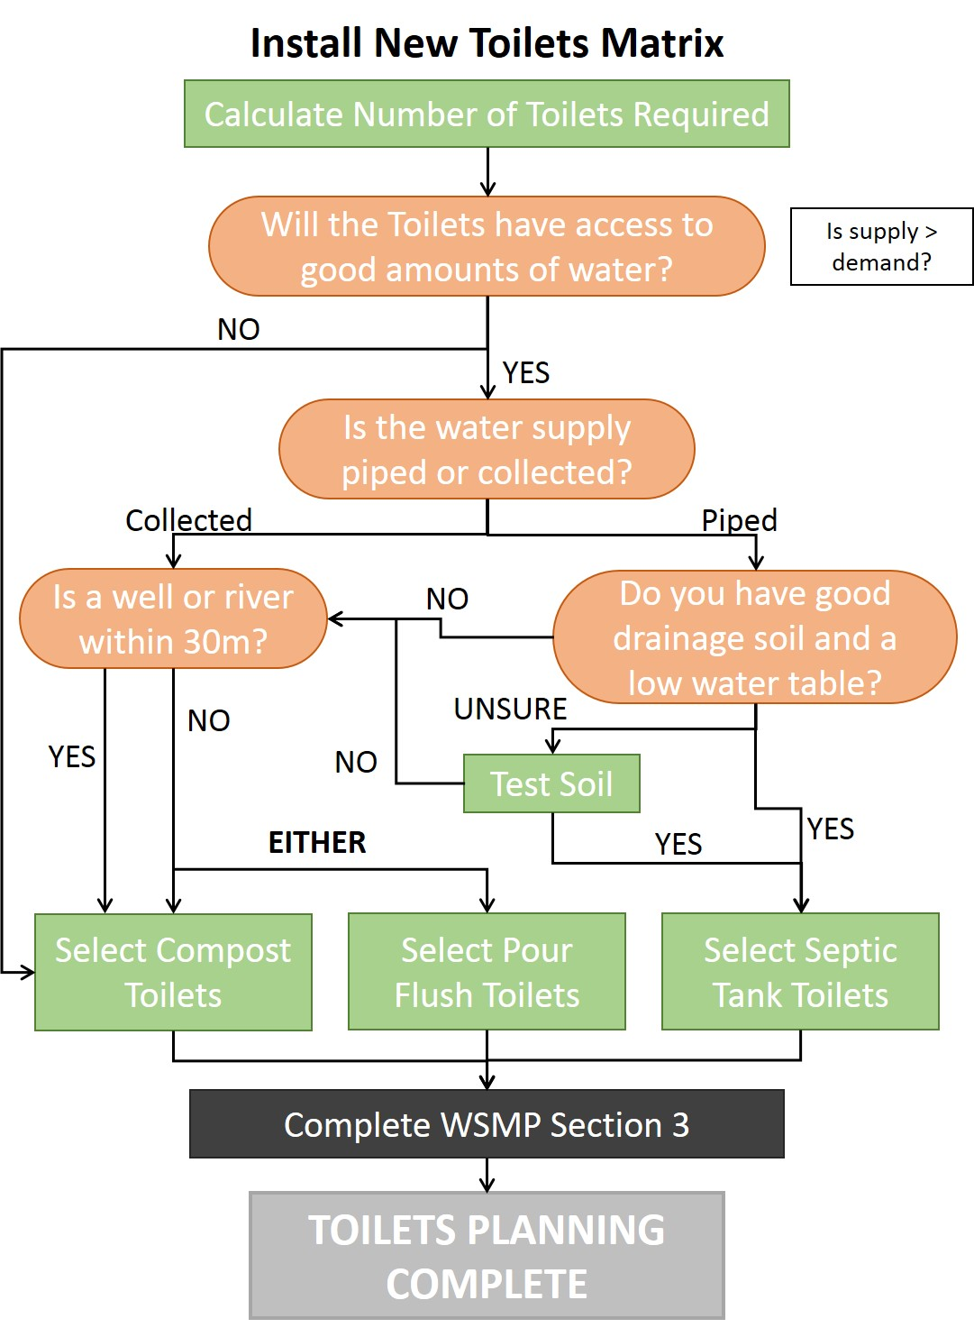
Waste System Design – Toilets
Identify number of toilets requireD
Is water supply adequate?
Select toilet type through decision tree
Fill in section 3C

Slide 25
Waste System Design – Toilets
Do existing toilets need upgrading?
Toilet Sanitary Survey
YES
Upgrade Toilets
NO
SYSTEM SECURE
Do existing toilets need upgrading?
Use Sanitary Survey data to answer
IF YES SEE “UPGRADE TOILETS” MATRIX

Slide 26
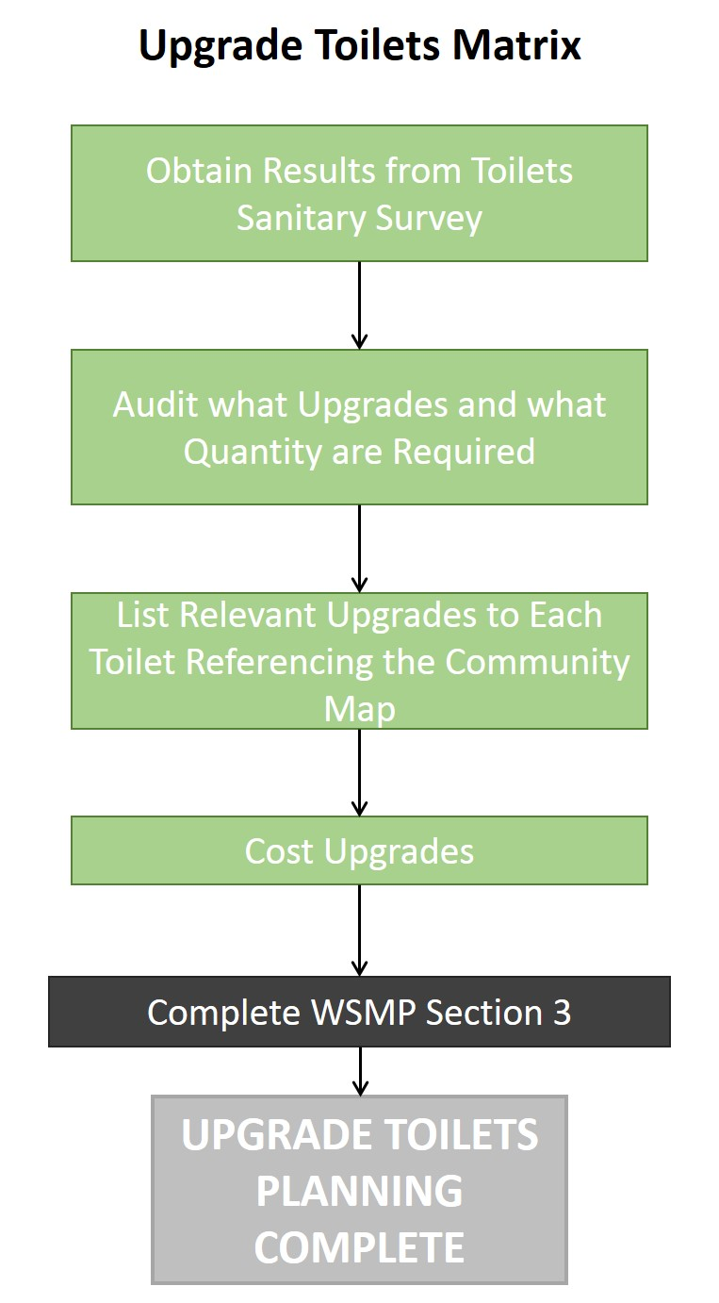
Waste System Design – Toilets
Identify how many toilets need upgrading
Audit and list requirements
Mark relevant upgrades on community map
Fill in section 3C
WHEN FINISHED – SANITATION PLANNING IS COMPLETE

Slide 27
End of Session

